Slide 1
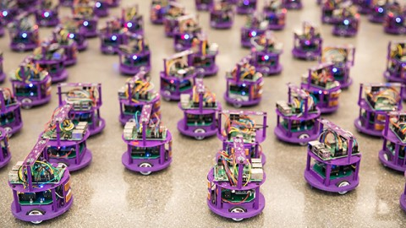
Autonomous Swarm Robots Proposal
Group 4
Meet Patel (400486035)
Jay Patel (400175525)
Vichal Daliya (400485779)
Tushar Bhuva (400486950)
Nikulkumar Dabhi (400490758)
Het Shukla (400490742)

Slide 2
Autonomous Swarm Robots

Slide 3
Project Overview
Build an autonomous multi-robot system popularly known as swarm robots is being built for performing the slow and risky tasks more efficiently than the humans in which the robots communicate and coordinate among themselves through their artificial swarm intelligence to complete the given end task.
The objective of our project is to build a small autonomous robot whose behavior can be traced from swarm intelligence.
The robot is either controlled by a master control robot or can take its own simple self - decision automatically.

Slide 4
Components Used
Arduino - 2 Nos.
RF Transmitter and Encoder Module - 1 No.
IR Sensors 2 Nos.
Arduino UART cable - 1 No.
L239D Motor Driver Circuit - 2 Nos.
DC motors - 4 Nos.
Wheels for Motors - 4 Nos.
Castor Wheels - 2 Nos.
Chassis - 2 Nos.
U Clamps - 4 Nos.
Wire stripper
Screwdriver
Connecting wires
Battery (9V)

Slide 5
Technologies to be used
Arduino IDE
Python Programming Language
C Programming Language
C++ Programming Language
Machine Learning & Computer Vision (For Future Scope)
Robotics

Slide 6
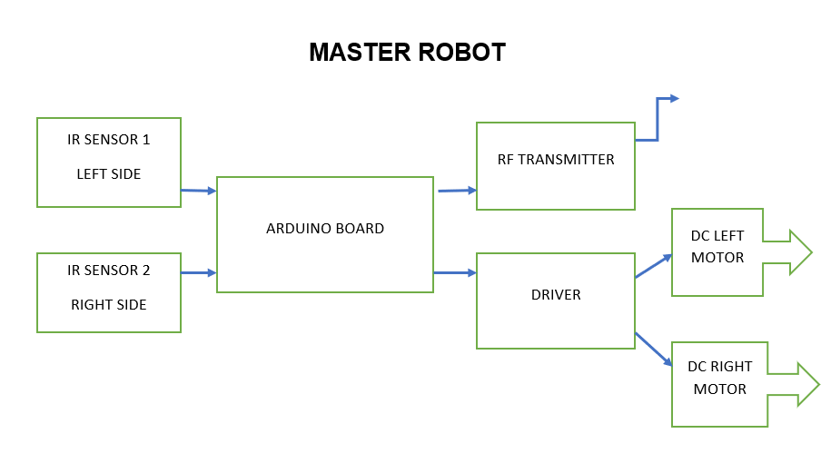
Flow Chart

Slide 7
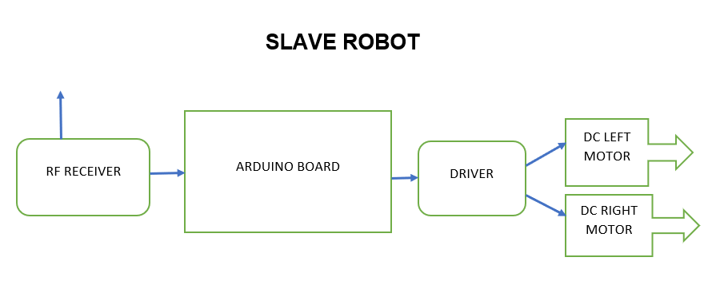
Flow Chart

Slide 8
Task to Perform
Requirement Analysis
Selection of Algorithm
Paper based simulating a blueprint of a project
Sketch the general structure of a solution
Hardware selection integration a Synchronization
Selection of Software Resources
Testing of algorithms
Designing and Building GUI
Coding
Implementation
Testing
Final Deliverables

Slide 9
Project Risks
Failure of hardware components such as motors, IR sensors, RF Transmitter and Encoder Module, etc.
The challenge of creating an effective communication protocol between the master and slave robots.
Availability and timely delivery of hardware components, leading to delays in the project timeline.
Unforeseen costs associated with hardware and software components, leading to budget overruns.
Competition from similar products and services in the market, leading to reduced demand for the proposed system.

Slide 10
Project Outcomes & Future Scope
Expansion of the Swarm: The current system consists of only two robots, but the number of robots in the swarm can be expanded to increase the efficiency of the task completion. The communication protocol between the robots can be optimized to handle a larger number of robots.
Enhanced Decision Making: Currently, the robots can take simple self-decisions or be controlled by a master control robot. The decision-making capabilities of the robots can be enhanced by incorporating more sophisticated algorithms and sensors.

Slide 11


